Slide 1


ITC Industry Churn
Deloitte Task

Slide 2
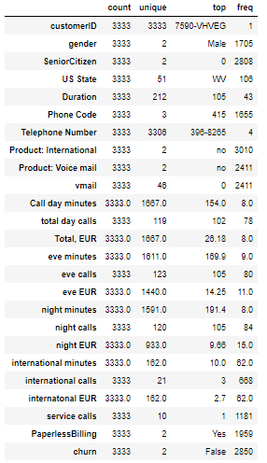
Data overview
Dataset has 24 feature and 1 target feature (churn).
There is no nulls in the dataset.
The dataset is small with only 3.333 observations.
Out of 3.333 observation, only 483 are with positive churn
27 Telephone Numbers are not unique, this will be ignored as the number is very small.

Slide 3
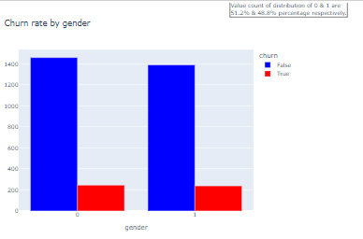
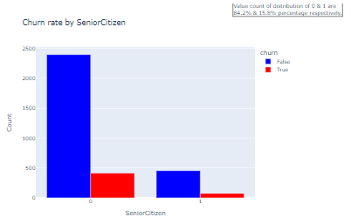
Gender and Senior Citizen with Churn
It seems that both Gender and SeniorCitizen have a very small effect on churn which is supported by the correlation.

Slide 4
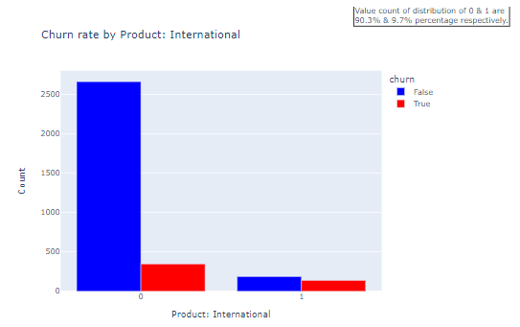
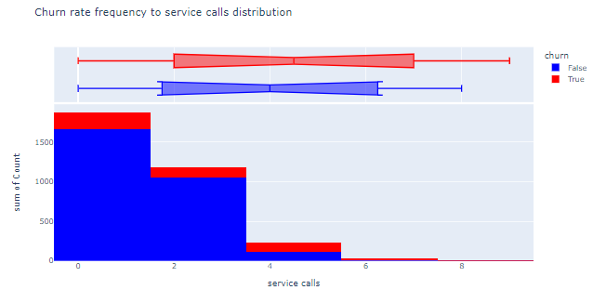
Product: International and service calls with Churn
It seems that both International and service calls have big effect on churn which is supported by the correlation.

Slide 5
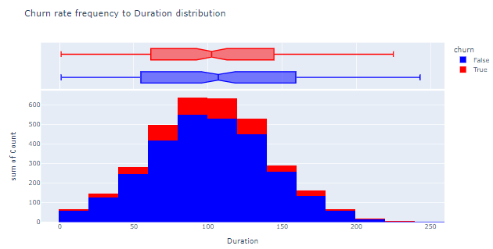
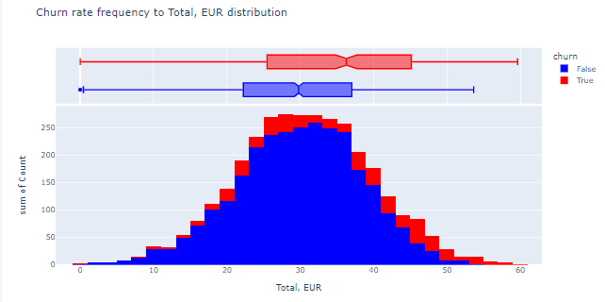
Distribution of numaric values
Most numeric values are normally distributed, this is showing that data near the mean are more frequent in occurrence than data far from the mean.

Slide 6
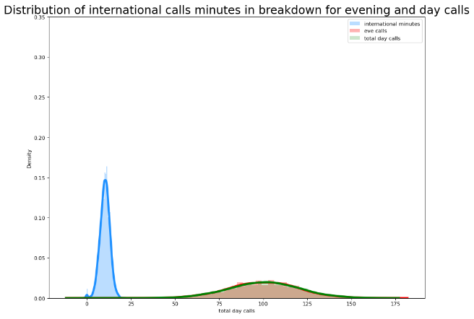
Distribution of international calls minutes in breakdown for evening and day calls

Slide 7
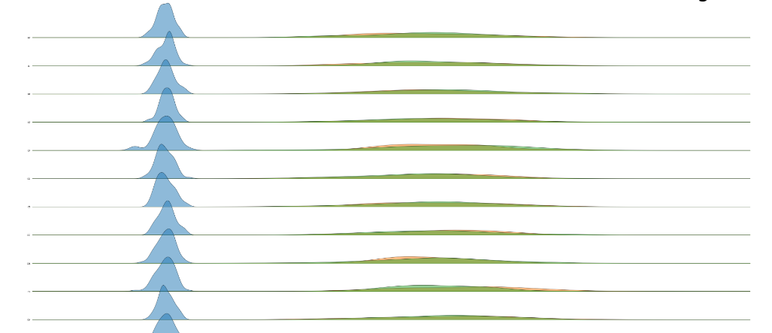
Per state distribution of international calls minutes in breakdown for evening and day calls

Slide 8
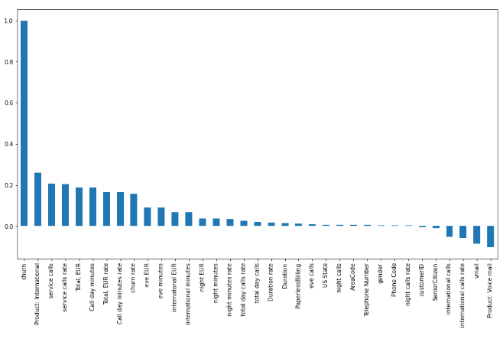
Assumptions on the features
As shown in the following correlation chart, the most correlated features with churn are the following:
Product: International
service calls
service calls rate
Total, EUR
Call day minutes
Total, EUR rate
Call day minutes rate
churn rate

Slide 9
Extra features needed
Most relevant features for churn are usually users engagement with the product and services.
Missing features include product characteristics, for example product type, product price, contract minimum term length, number of parallel contracts.
Service related like broadband speed, network coverage.
User type: Private or business, new user flag.
Date of churn, very important for productive models, can be used as both features and filters to filter training data.

Slide 10
New Features
Area code is extracted from the phone number.
Following features are generated by dividing each feature with same feature per state rate:
total day calls
night calls
international calls
Duration
Total, EUR
service calls
Call day minutes
night minutes

Slide 11
ML models
Churn prediction here is treated it as a classification problem, classifying a customer as yes/no for churning.
Logistic Regression:
easy to explain and implement
with only thousands of data points, there may not be enough data to get very good results

Slide 12
ML models
Random Forest:
can yield good results with less data, so it’s one of the best classification models for churn prediction
since we use grid-search method and the feature size is not so big, feature selection isn’t necessary.
It will automatically select the best features at each node of ensemble trees anyways.
to select the best hyperparameters, a 5 fold cross validation is used
XGBoost:
good option for mid-size datasets
To select the best hyperparameters, a 5-Fold Cross Validation with bayesian search is used.

Slide 13
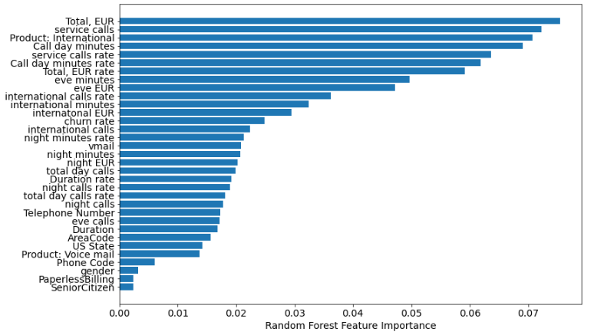
Random Forest – Most Important Features

Slide 14
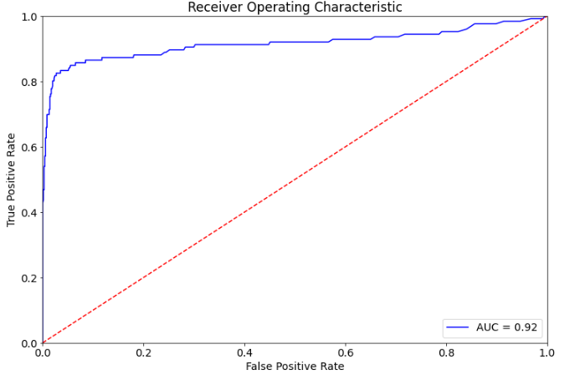
Random Forest - ROC
High TPR/Recall is achieved while maintaining a low FPR. Depending on our tolerance for False Positives, we can increase our TPR as well by shifting the threshold.

Slide 15
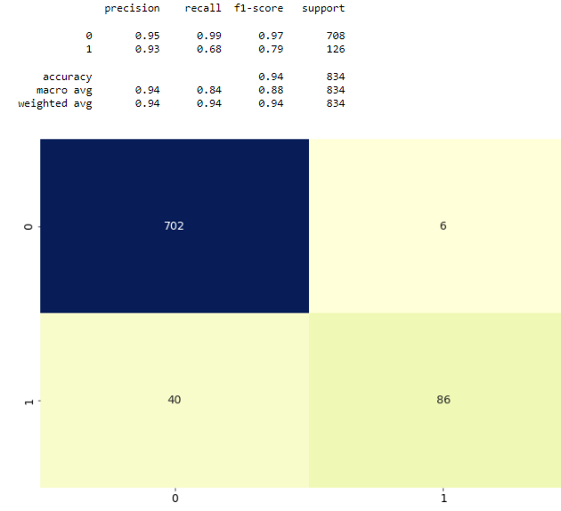
Random Forest - Confusion Matrix
Accuracy best score: 0.93
The focus for the Random search is to find the best parameters to maximize precision average.
Confusion matrix for our Test predictions shows the values as follows:
Predicted not to churn and not churned TN | Predicted not Churned but churned FP
Predicted to churn and not churned FN | Predicted to churn and churned TP
The main focus should be on minimizing false positive and false negative, this can be done by optimizing the precision and recall.
For our demonstration I focused on optimizing the precision.

Slide 16
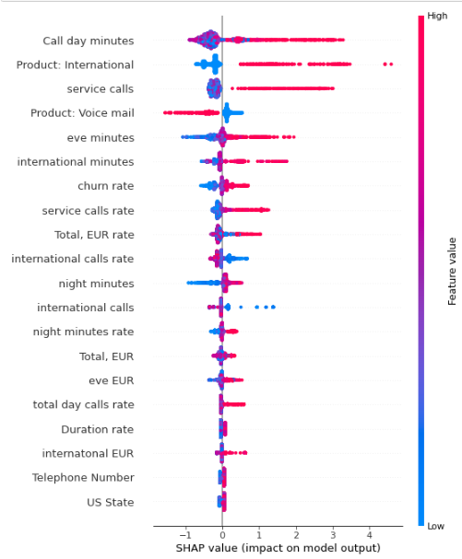
XGBoost – Most Important Features
Product International high value (True) has the biggest impact on model output.
The same goes for service call, eve minutes and churn rate.
Product voice call low values (False) has the biggest impact on model output.
Total, EUR feature in XGBoost has less impact on the model and random forest.

Slide 17
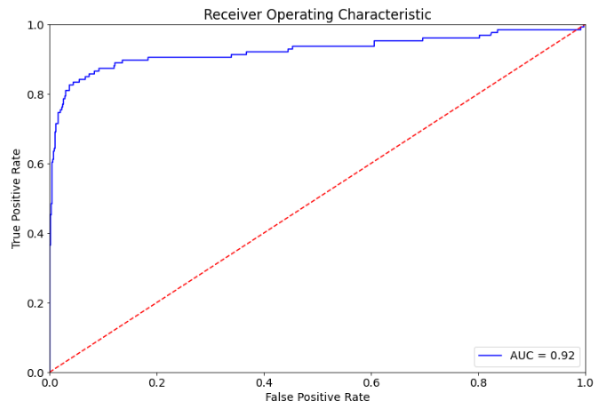
XGBoost - ROC
Also high TPR/Recall is achieved while maintaining a low FPR. Depending on our tolerance for False Positives, we can increase our TPR as well by shifting the threshold.

Slide 18
XGBoost - Confusion Matrix
Accuracy best score: 0.94
The focus for the XGBoost grid search is to find the best parameters to maximize precision average.
Confusion matrix for our Test predictions shows the values as follows:
Predicted not to churn and not churned TN | Predicted not Churned but churned FP
Predicted to churn and not churned FN | Predicted to churn and churned TP
The main focus should be on minimizing false positive and false negative, this can be done by optimizing the precision and recall.
For our demonstration I focused on optimizing the precision.

Slide 19
XGBoost VS Random Forest
XGBoost showed slightly better score and false negative, which is our focus to minimize the number of users which we predict as positive which eventually won’t churn.

Slide 20
ML testing, best practice
there are differnt types of testing which can be considered:
Cross-validation while training the model: for this scenario 5 fold cross validation is used to test the trained model
Automated tests for model verification: by applying smoke test, unit tests and finally integration tests
unit tests and integration tests help to prevent low-quality data from entering the training pipeline.
Manual model evaluation and validation: done by domain expert generated and reviewed a model quality report

Slide 21
Azure synapse workspace
The following steps will be taken in case i have access to Azure synapse:
Open Azure machine learning workspace lined service in synapse
Open Azure new notebook for EDA and preprocessing
Access to the churn data maybe in sql in synapse workspace
Make the EDA and preprocessing using synapse workspace
Train and test the needed models in the created notebook, each model in a separate file, analyse the results
Use one of ml model interpretation tools to share the results, ex. SHAP, Mimic

Slide 22
Azure synapse workspace
The following steps will be taken to automate the model run:
In synapse studio, Integrate hub, select Pipeline and create notebooks for reach stage
In Model training part, set a threshold for the new model score generated, for example 0.85
The threshold will guarantee the quality of the regularly trained model
The score here is either precision or recall in case of churn
Add the init function to deploy the model
Add the run function to predict unseen new data
Use SHAP to explain and monitor the model performance
Schedule the pipeline to run every month

Slide 23
Questions?
☺

